Slide 1
MAPC Team 1
Broadband Digital Equity
Richard Andreas
Ben Sui
Gonzalo Rosales
Jake Lee
Jeffrey Li

Slide 2
Background and Motivation
The Metropolitan Area Planning Council (MAPC) would like to advocate for funding towards increasing broadband access across the state of Massachusetts
Assist with analysis of which municipalities should be prioritized for broadband funding based on census datasets with features such as income, ethnicity, unemployment, and income
Special focus on using the FCC’s broadband speed data, which it collects through its mandatory Form 477 reporting process, in which it requires internet service providers (ISPs), to report their maximum upload and download speeds
Notes:
We, Team 1 of this project, will be specifically focused on mapping out the digital divide across municipalities in Massachusetts to analyze discrepancies between the resident's needs and existing service from current providers. We will accomplish this by analyzing FCC data, in addition to the MAPC's existing features.
While we are aware that finding answers to all the following questions may not be possible through the provided FCC dataset, they drive our approach to the problem and are ones we have kept in mind throughout the process:
What are discrepancies in coverage and speeds among MA municipalities?
Is there any evidence of digital redlining? For example, do municipalities with a high percentage of underrepresented groups receive poor coverage relative to the rest of the population?
How do broadband providers vary in the three gateway cities, Revere, Everett, and Quincy, that the MAPC has asked us to focus on?
What are the leading predictors for higher broadband speeds in MA?

Slide 3
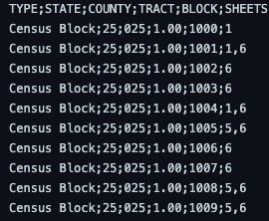
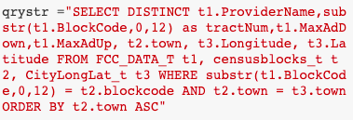
Procedure
Collected data on the municipalities located around Massachusetts and preprocessed them for data analysis, mapping census block codes to their corresponding areas.
Analyzed this data to find potential relationships between broadband speeds and several variables via scatter plots and bar graphs, alongside comparing top and bottom plots per relationship:
Number of Providers
Median Income
Maximum advertised upload speeds
Maximum advertised download speeds
Race
Created heatmaps to visualize areas throughout Massachusetts with the varying concentrations of data points for each of the aforementioned variables.

Slide 4
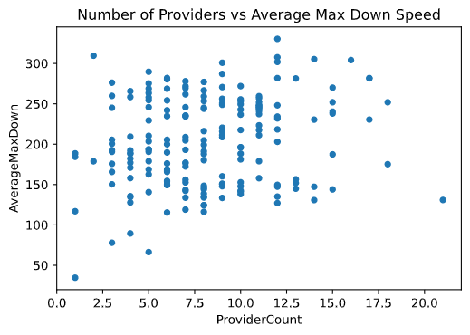
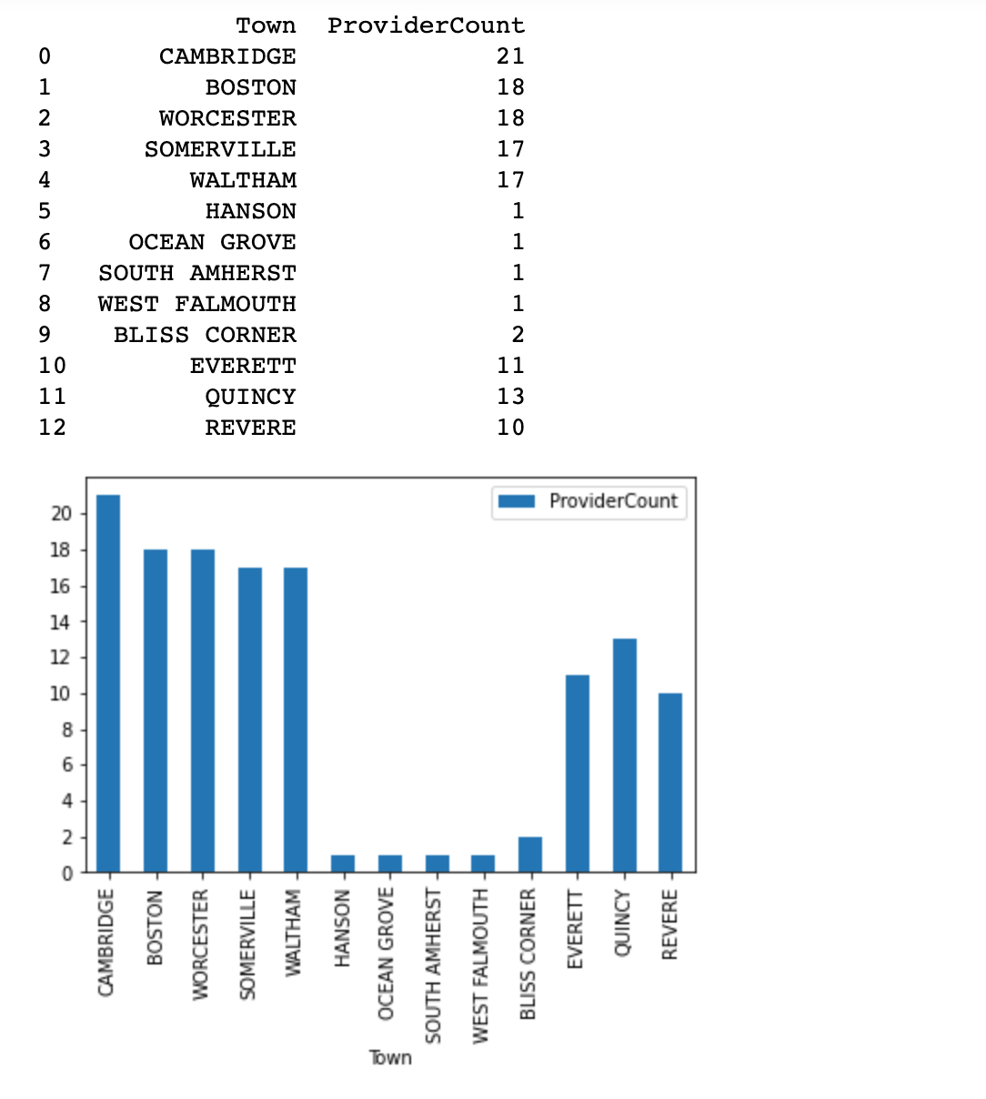
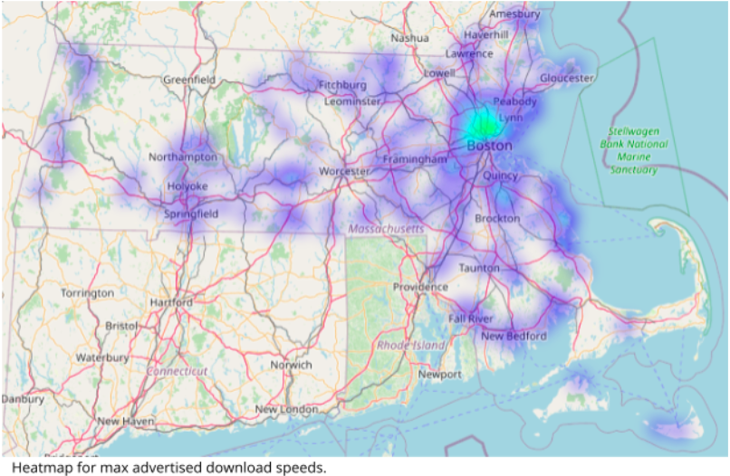
Results
Plotted several scatter plots and bar graphs with demographics as a metric and internet speeds as another:
Median Income vs Advertised Max Speeds
Number of Providers vs Advertised Max Speeds
Unemployment vs Advertised Max Speeds
Notes:
With the concept that providers serve as mutual competitors, we had anticipated for higher advertised speeds in areas with more providers. In other words, we had expected to see an upwards trend, perhaps a linear one; as the number of providers increases, so too will the maximum advertised speeds. However, this notion was ultimately incorrect. As touched upon in the previous section, ISPs do not seem to entirely be competing with one another.

Slide 5
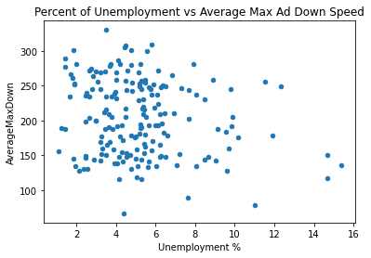
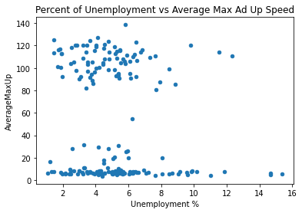
Insights and Need for Representative Data
Huge disparity between advertised download and upload speeds. Need for clear distinction between available plans and broadband technologies in municipalities
Notes:
If we focus on the right graph compared to the one on the left, which shows us the correlation between unemployment and advertised speeds, we see that there is a huge gap between the advertised upload speeds. We hypothesize that this could be due to technologies that offer gig speed internet such as fiber, but since FCC doesn’t collect specific plan data, we can currently not tell.

Slide 6
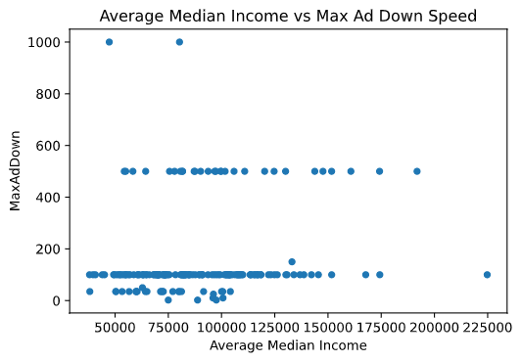
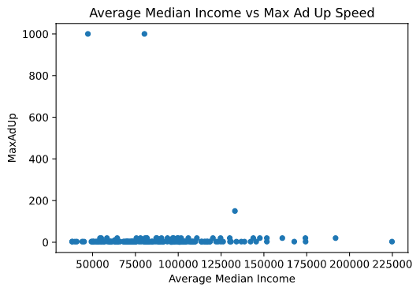
Insights and Need for Representative Data
Notes:
If we focus on the right graph compared to the one on the left, which shows us the correlation between unemployment and advertised speeds, we see that there is a huge gap between the advertised upload speeds. We hypothesize that this could be due to technologies that offer gig speed internet such as fiber, but since FCC doesn’t collect specific plan data, we can currently not tell.

Slide 7
Limitations & Challenges
Since ISPs self-report data, and they're only required to report maximum advertised upload and download speeds, the FCC dataset is very flat.
Census tracts to zip codes is not a 1:1 mapping
Difficult to distinguish between municipalities that own their own broadband infrastructure
Lots of variables may contribute to broadband speed and access, requiring lots of trial and error
Notes:
Flat data -> Max and Min available, required advertised price for each speed given

Slide 8
Final Thoughts and Next Steps
A lot of our findings further justified the need for the FCC to change the data they require ISPs to report beyond just advertised speeds. There is a need for the FCC to require companies to report actual real world speed and plan data
The FCC announced in January new rules for broadband data mapping, such as requiring companies to have speeds be verified by a third party
While step in the right direction, unclear whether this will require companies to distinguish between plans
No specified date for implementation in Form 477 reporting

Slide 9
Thank You

